Slide 1

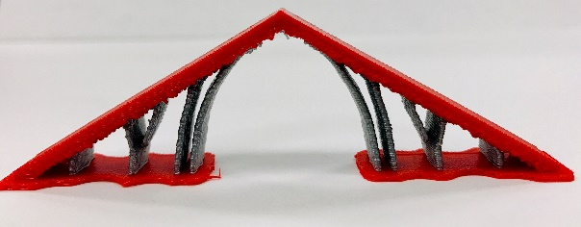
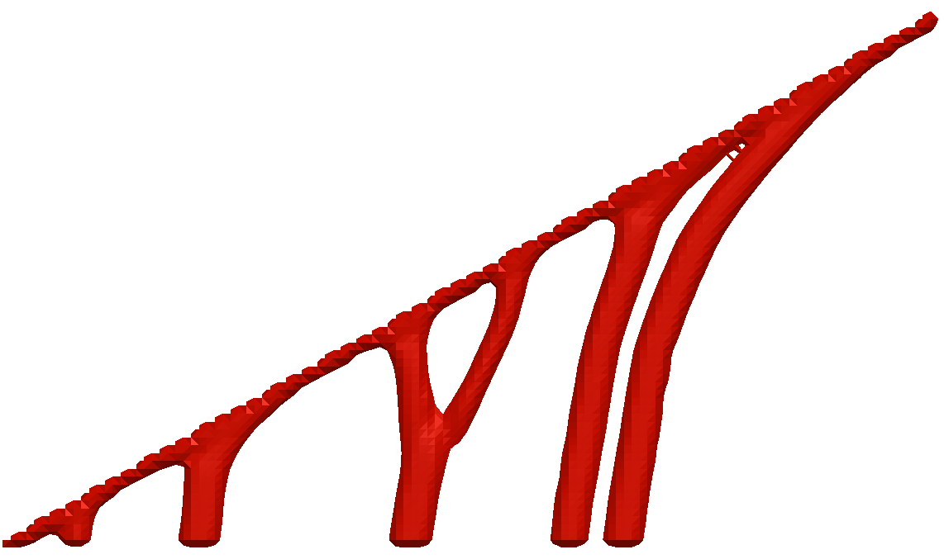


Support Optimization for AM via Pseudo-Fiber Material Model
Design
Q
Support Domain
T
Aaditya Chandrasekhar
Prof. Krishnan Suresh

Slide 2
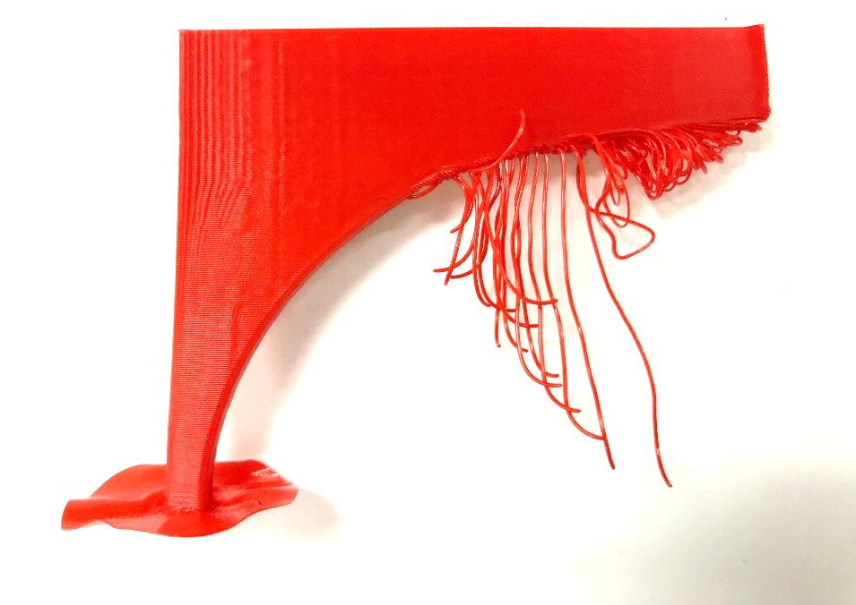
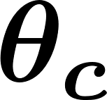
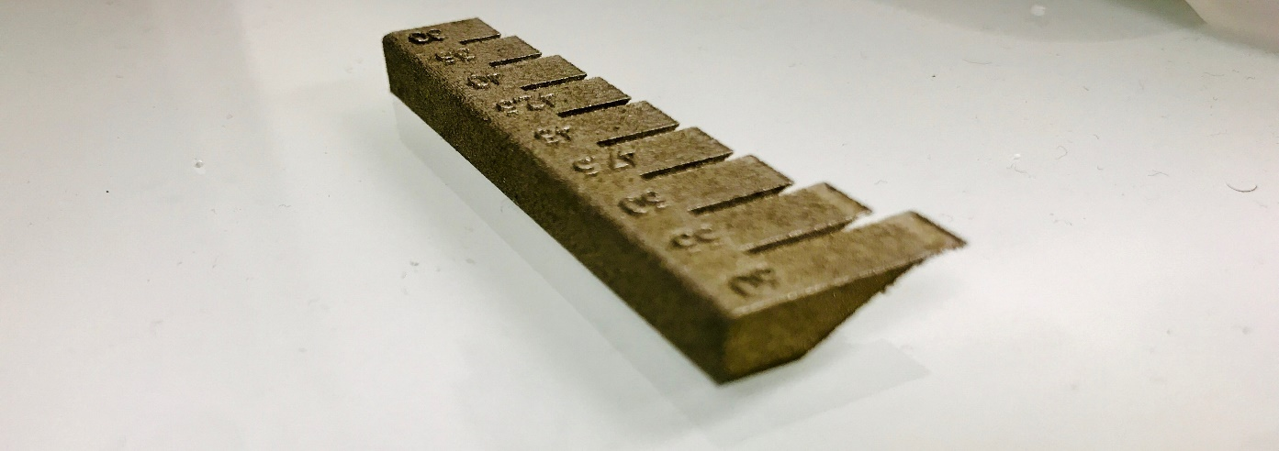
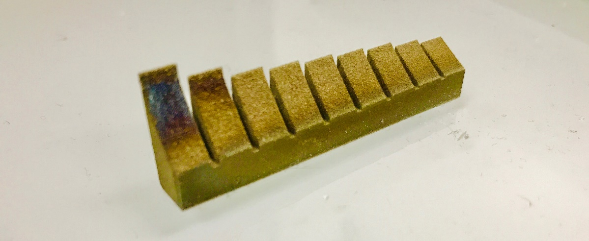
Support structure in AM
1) Decrease material consumption for support
material wastage FDM [1]
material consumption FDM [1]
Overhanging print
2) Improve support’s heat conduction
Unsupported overhangs in metal printing causes burning
[1] Ruoyu Sang , 2016
Notes:
The need for support structure in AM is something we all recognize. Take for instance the two

Slide 3




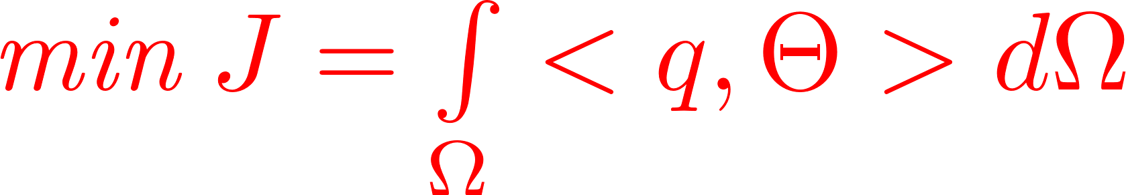
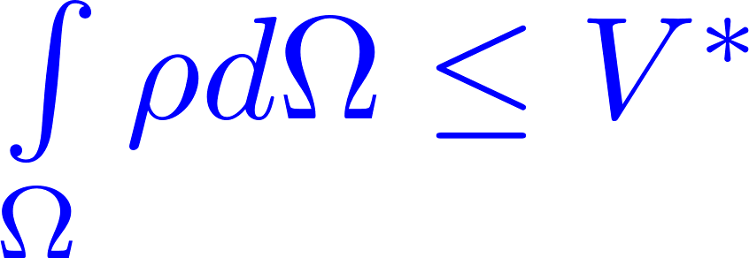

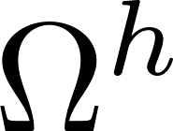

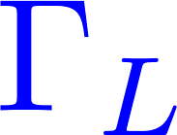
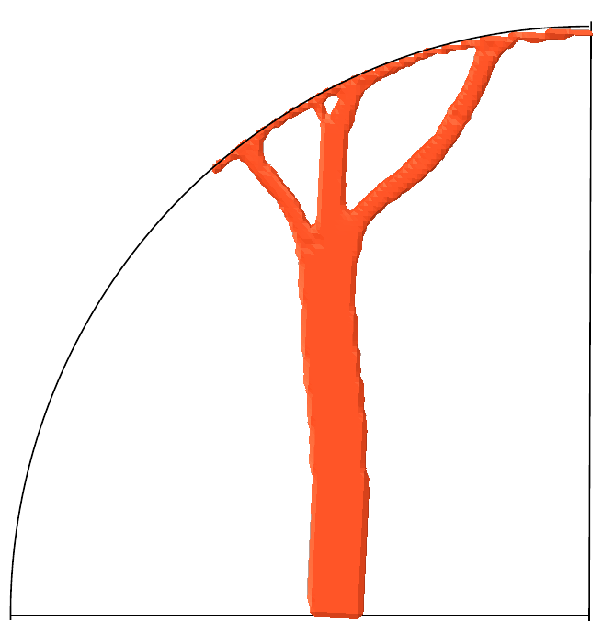
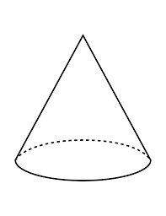
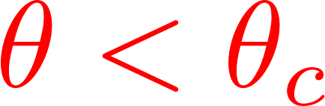

Simplistic View
Improve support’s heat conduction
Decrease material consumption for support
Design
Q
Support domain
+
Physics
Thermal/Structural
T
Not self-supporting!
Need to make support self-supporting

Slide 4
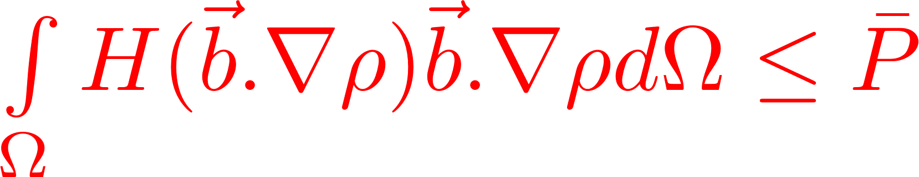
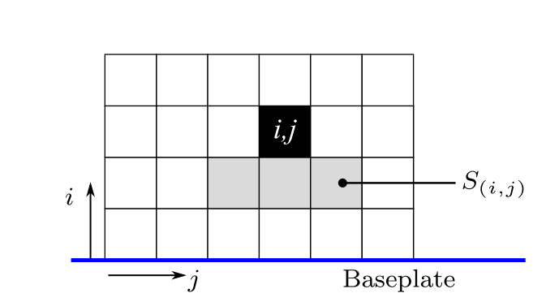
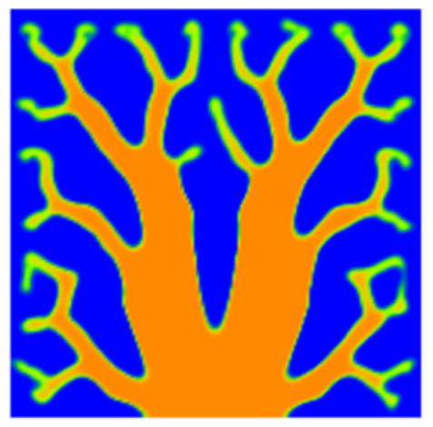
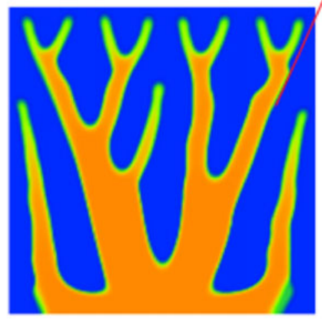
Literature (Physics & SIMP)
Overhang constraint
[Qian 2017]
Density filtering
[Langelaar 2017]
Perimeter constraint
Blueprint filter
Neighborhood constraint
Penalize overhang using density gradient
Implicit control on overhang ?
Notes:
Langelaar what is - the drawback ? – Quote from the paper

Slide 5
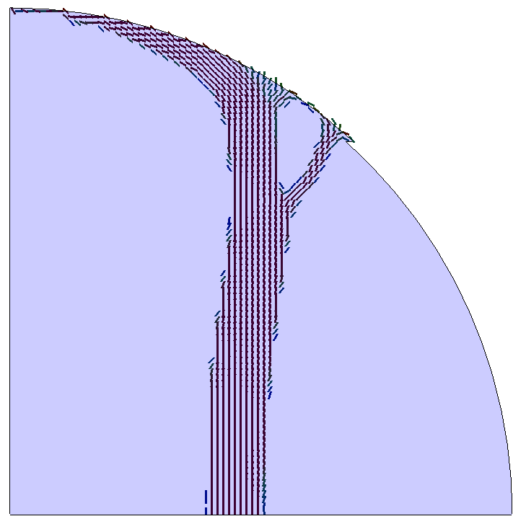
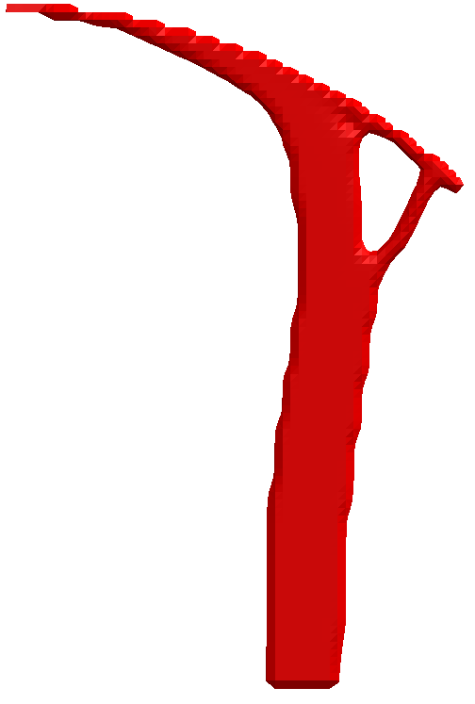
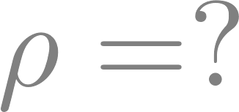
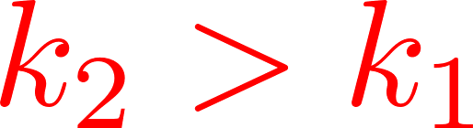
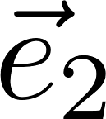
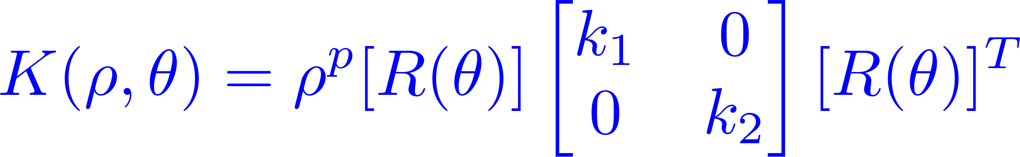

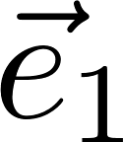

Concept
Design
Support domain
Pseudo-Fiber

Slide 6
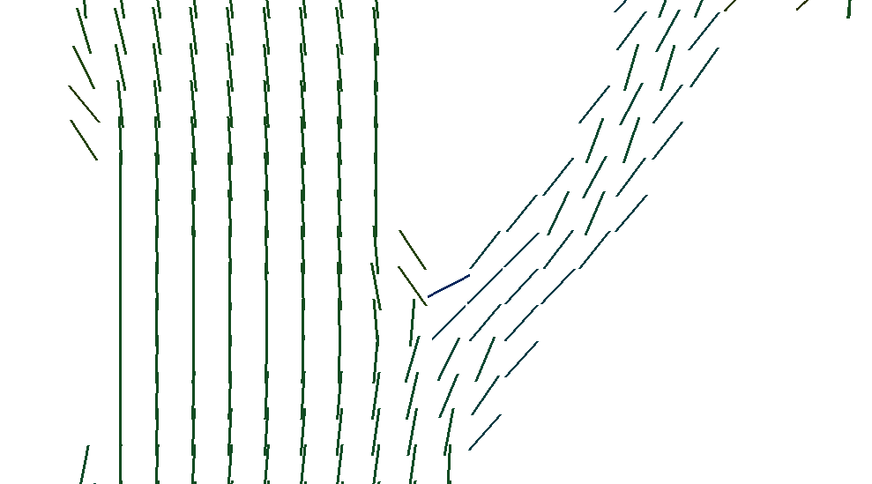
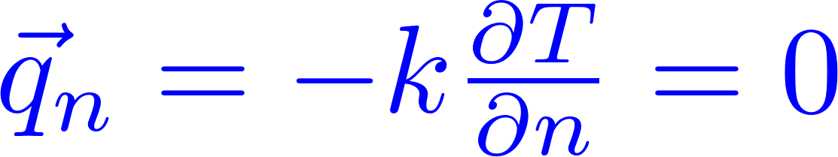

Concept
Surface normal
Fiber normal
Use pseudo-fiber physics to control overhang

Slide 7
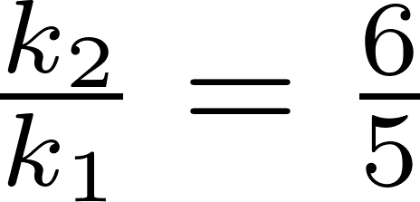
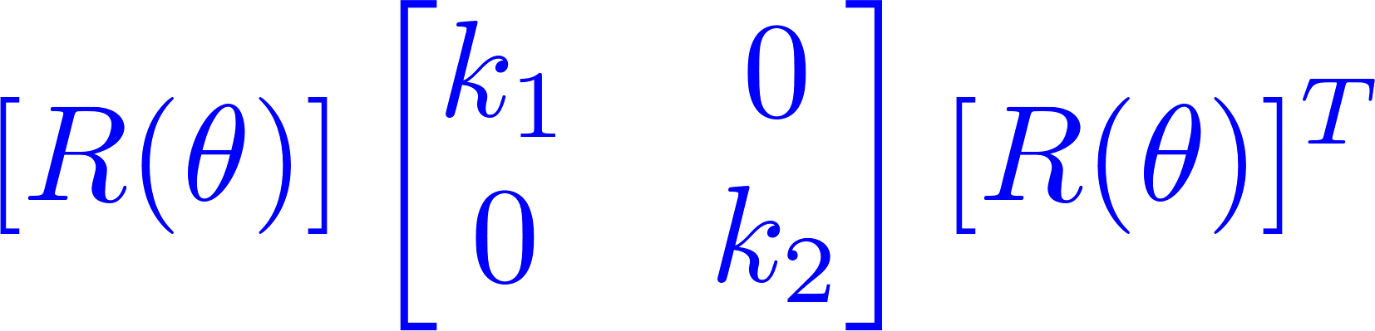
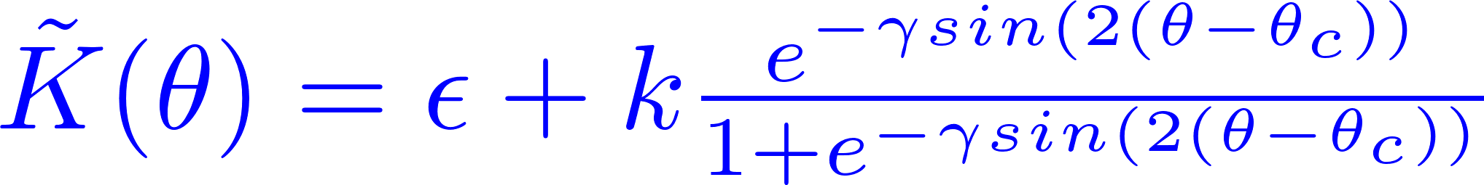
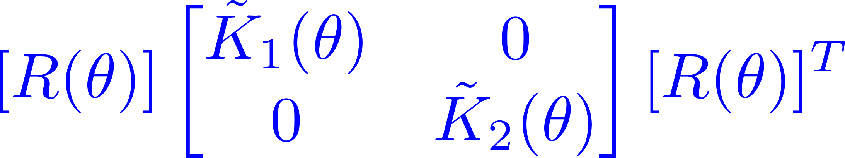
Tuned Fiber-Physics
Rotation
Decay
+
=
Overhang angle
Decay rate

Slide 8
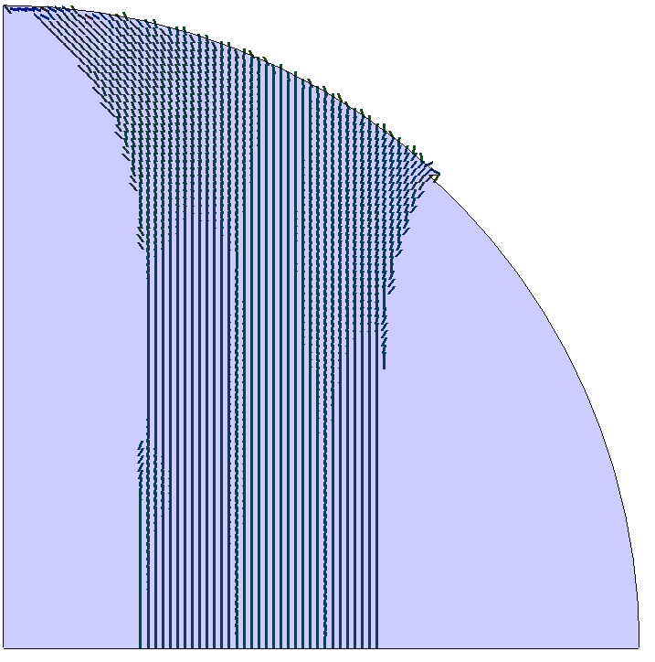
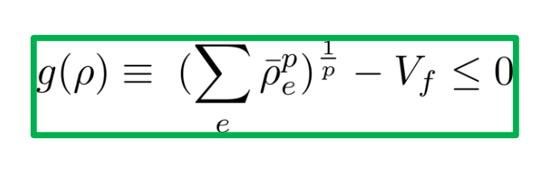
Length scale control
Max length scale :
Maximize surface area
Internal fibers interfere with boundary control
[Guest 2009]
[Wu 2018]
R
+
Average density about element constrained

Slide 9
Summary
SIMP
Tuned Physics Fiber
Length scale control
Support optimization

Slide 10
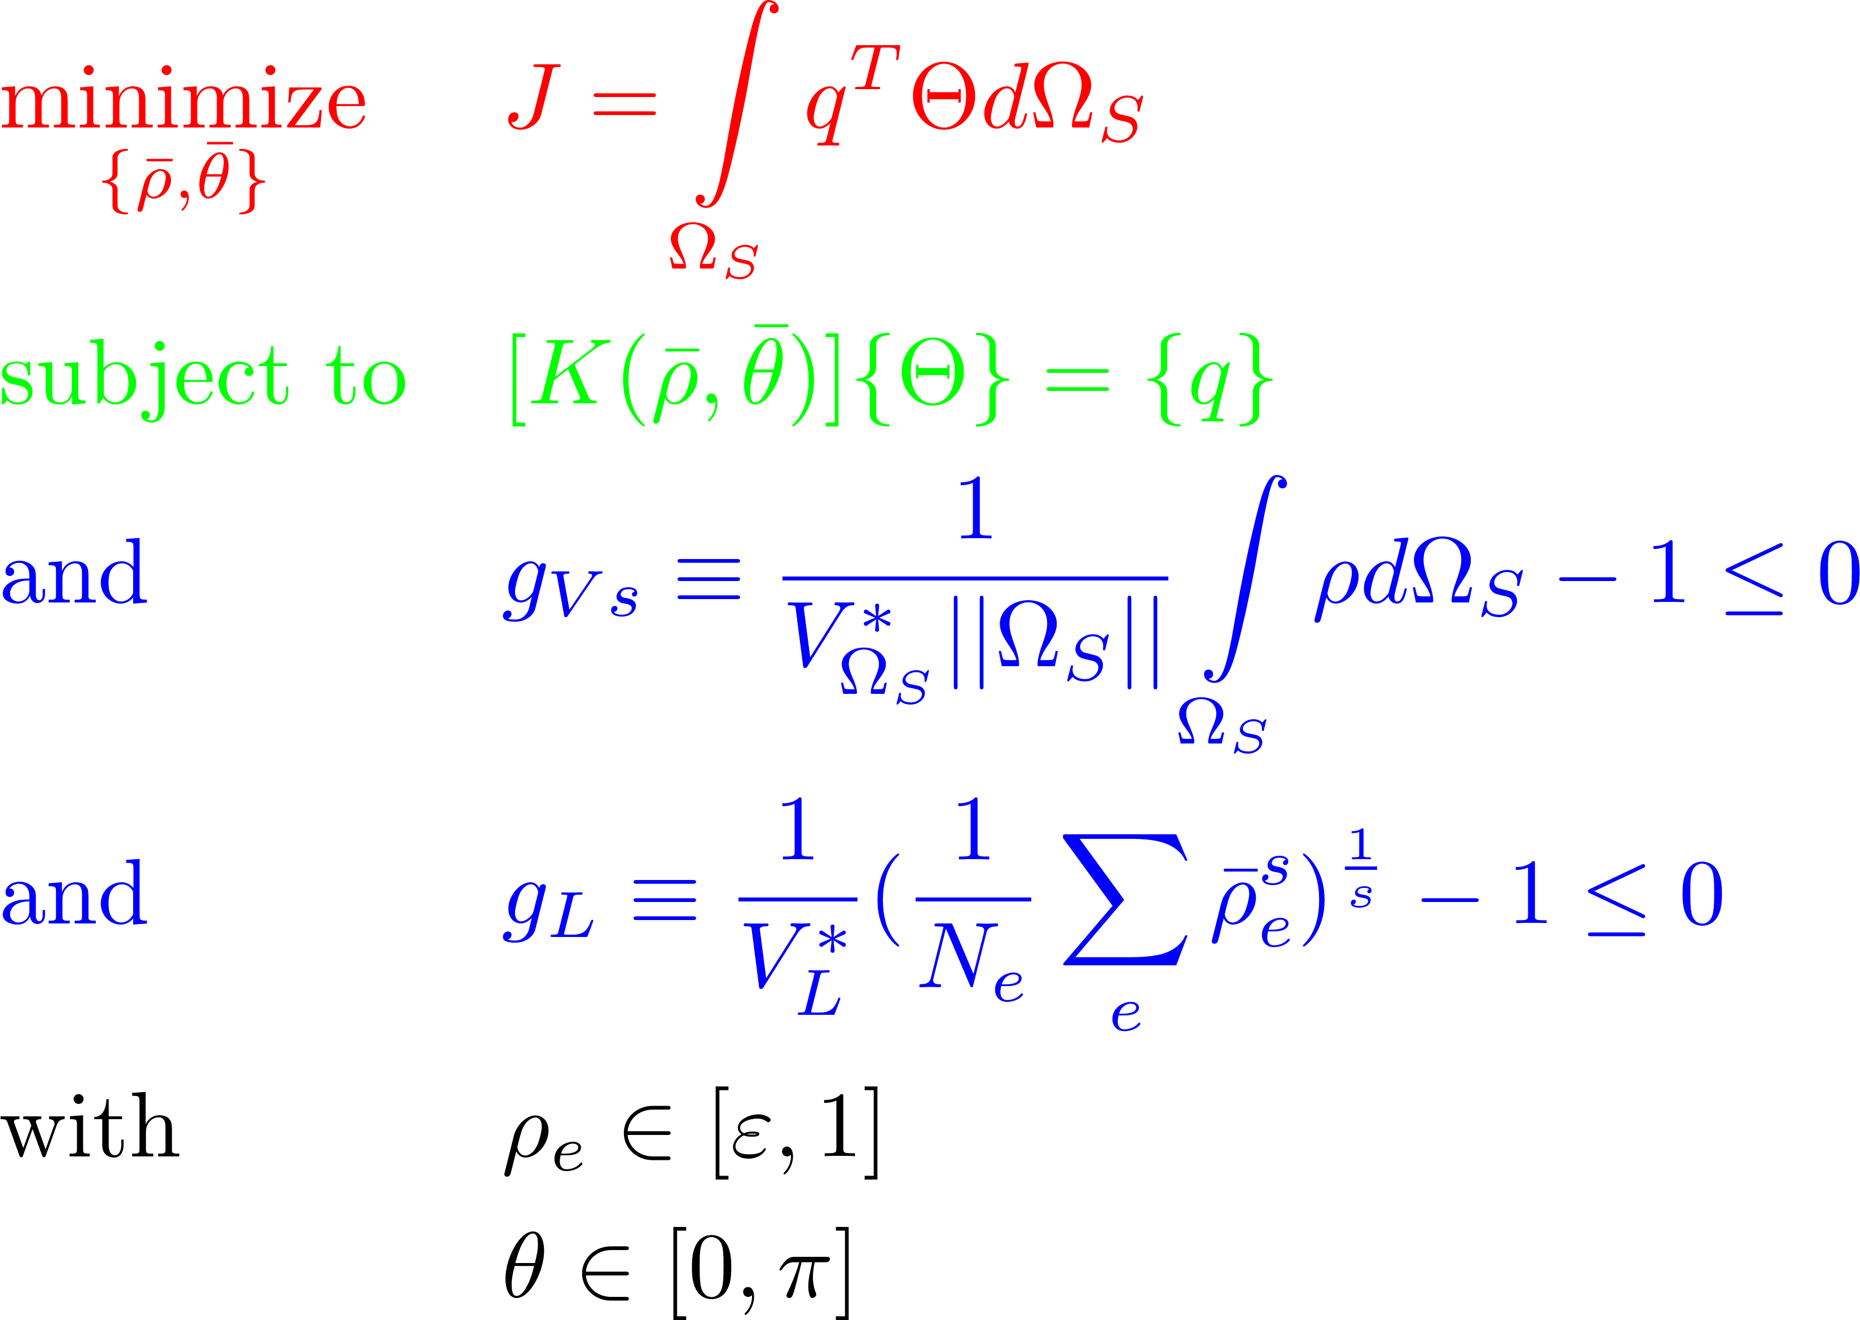
Optimization Summary
Thermal compliance
Heat equation
Volume constraint
Length scale control
Bounds on variables

Slide 11

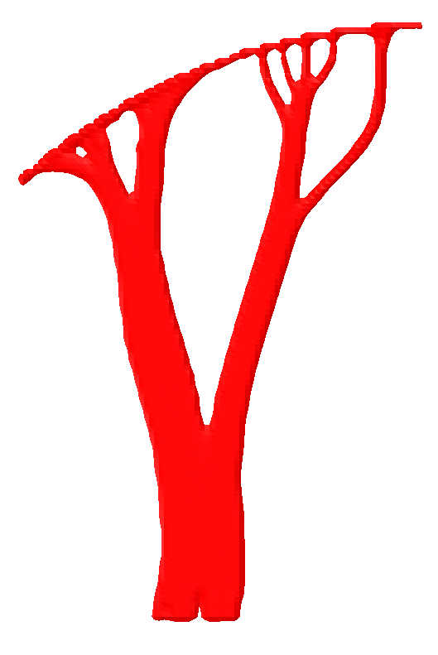
Comparison
Isotropic
Anisotropic – no tuning physics
Tuned Fiber physics for overhang control

Slide 12
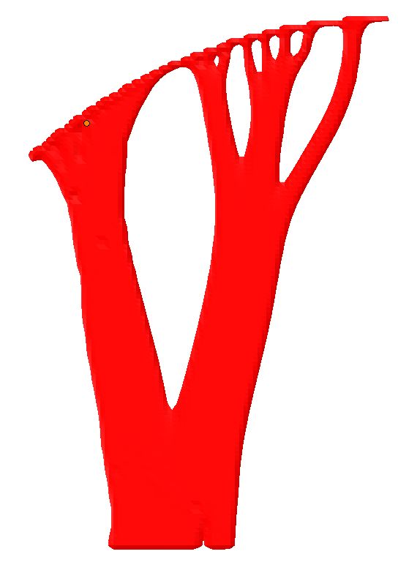
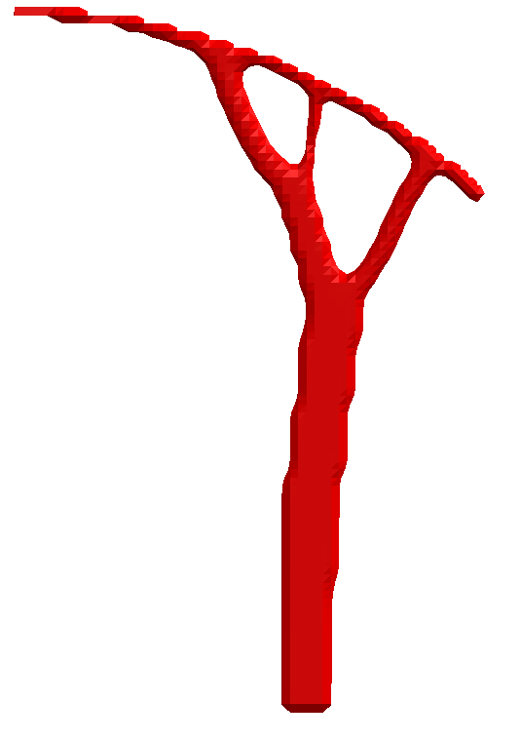


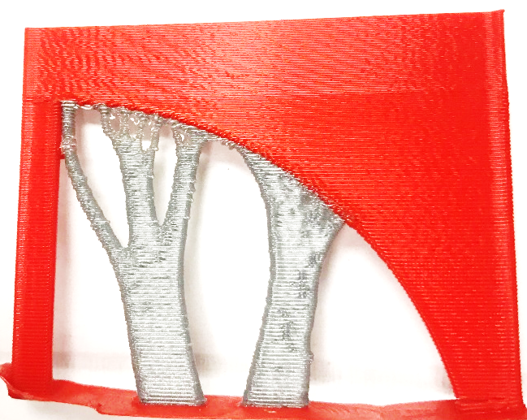
Results – Curved domain
Design domain
Support domain
Optimal choice of volume fraction ?
Notes:
Show the original figure before (standard) optimization – No fiber / with fiber + tuned physics

Slide 13
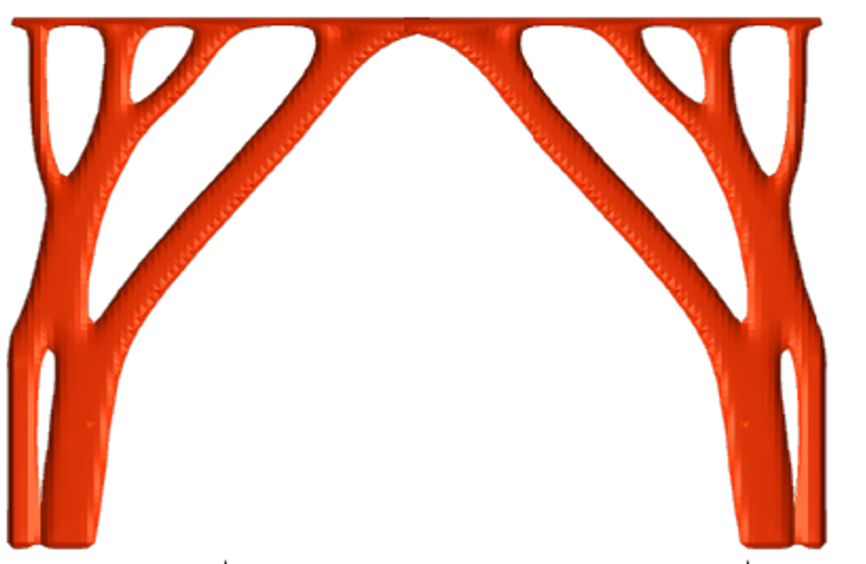
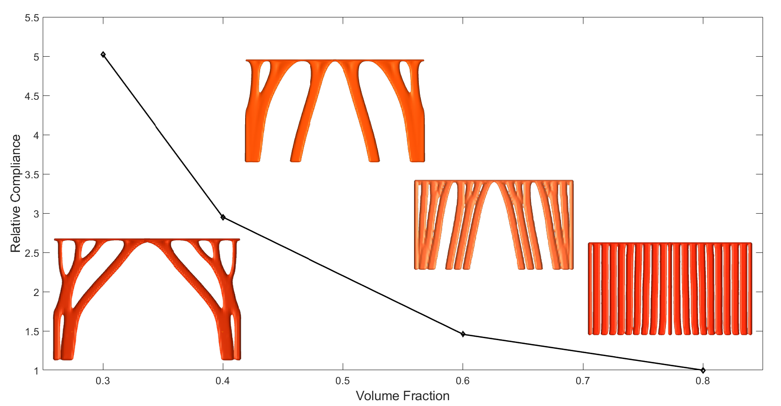
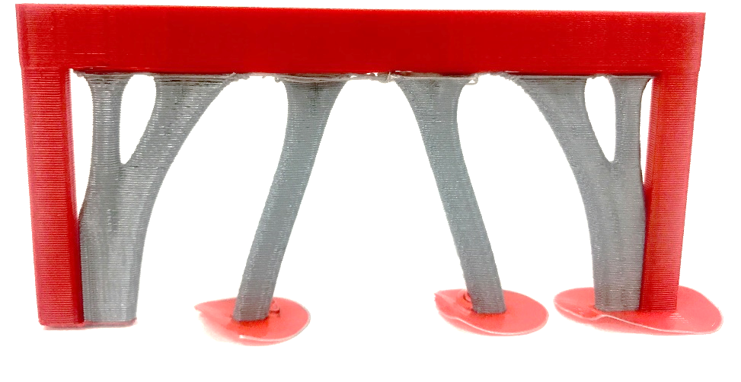
Results – Rectangular domain
Design
Support domain

Slide 14
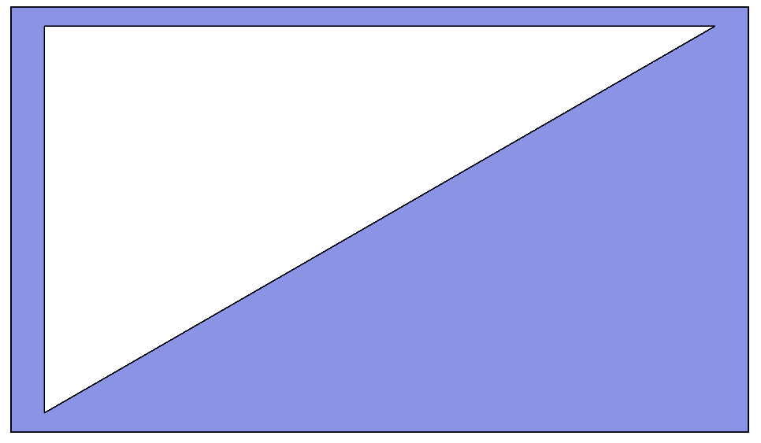
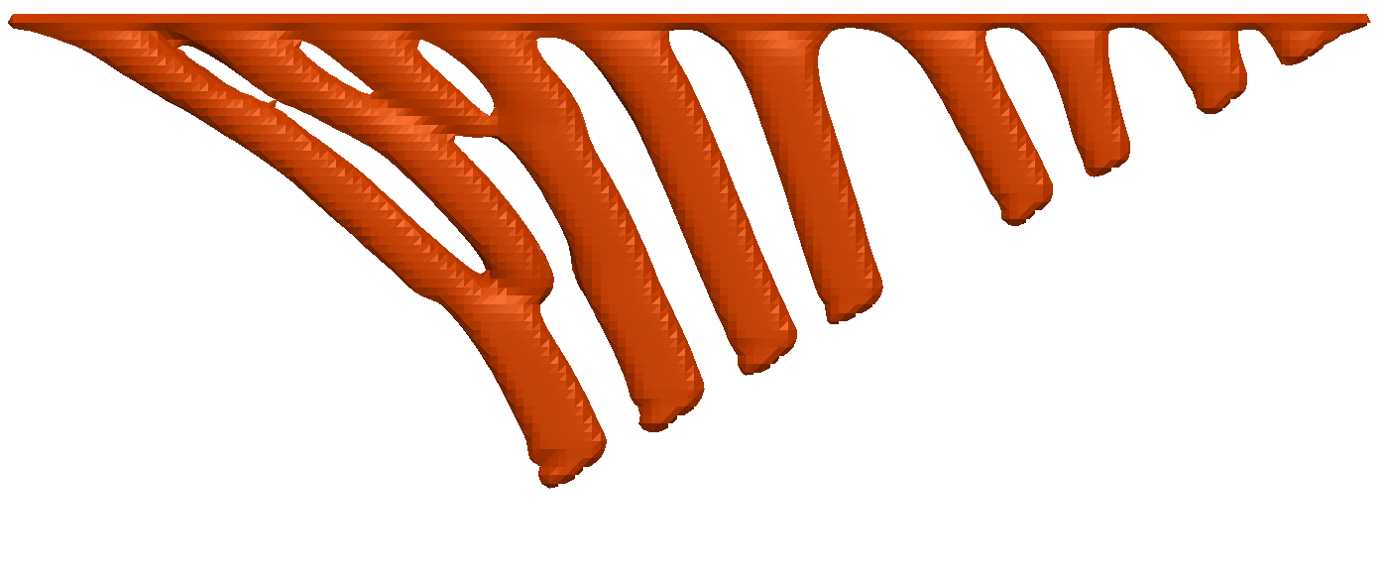
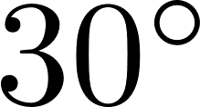
Result Triangular domain
Q

Slide 15
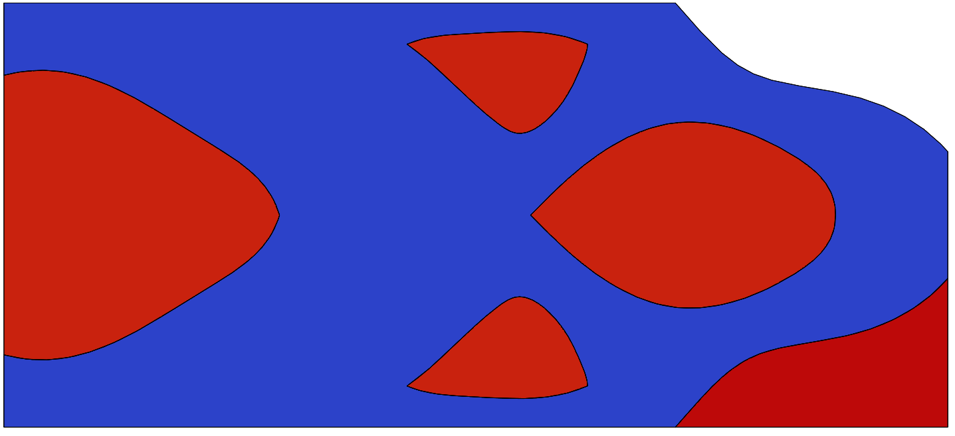
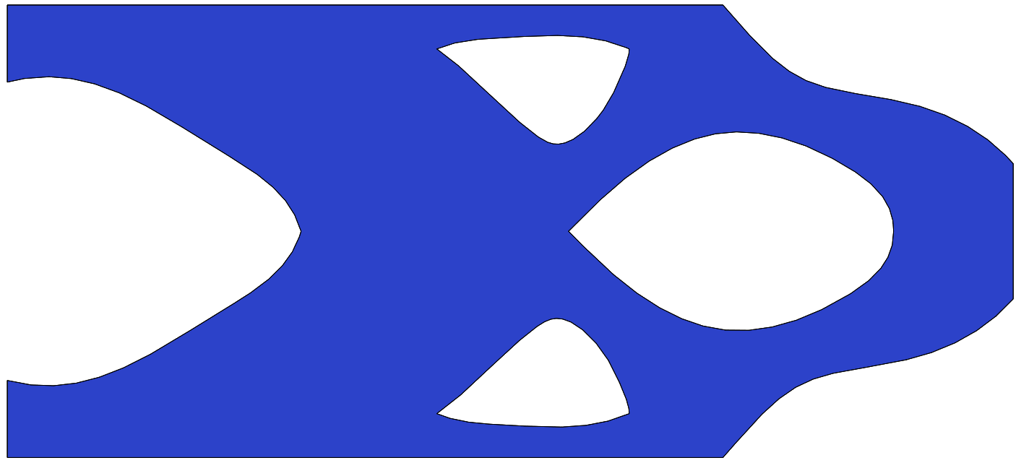
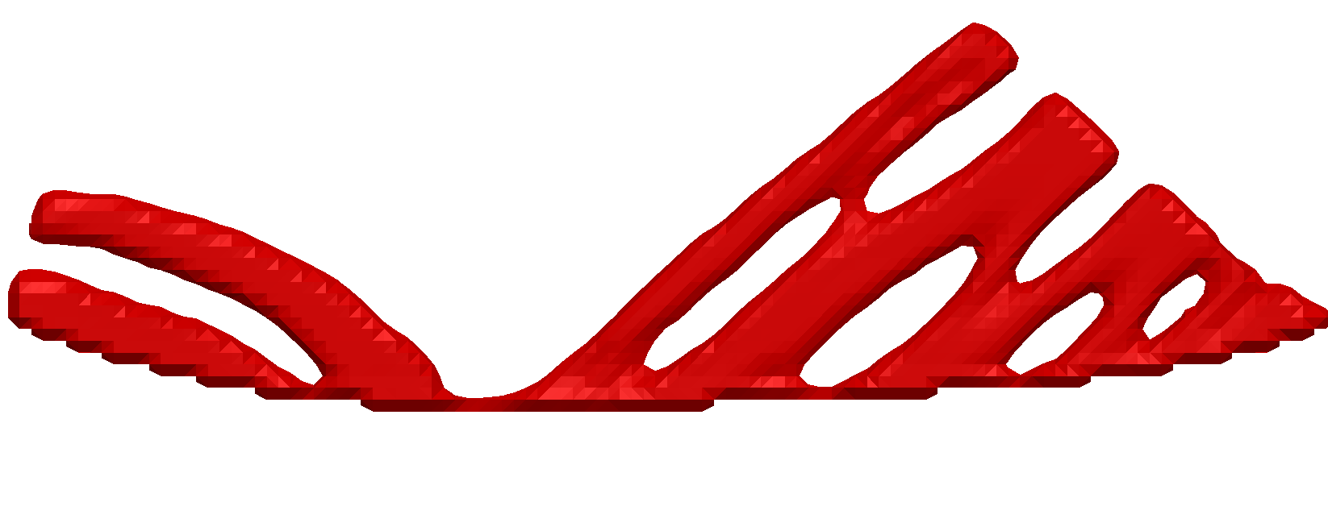
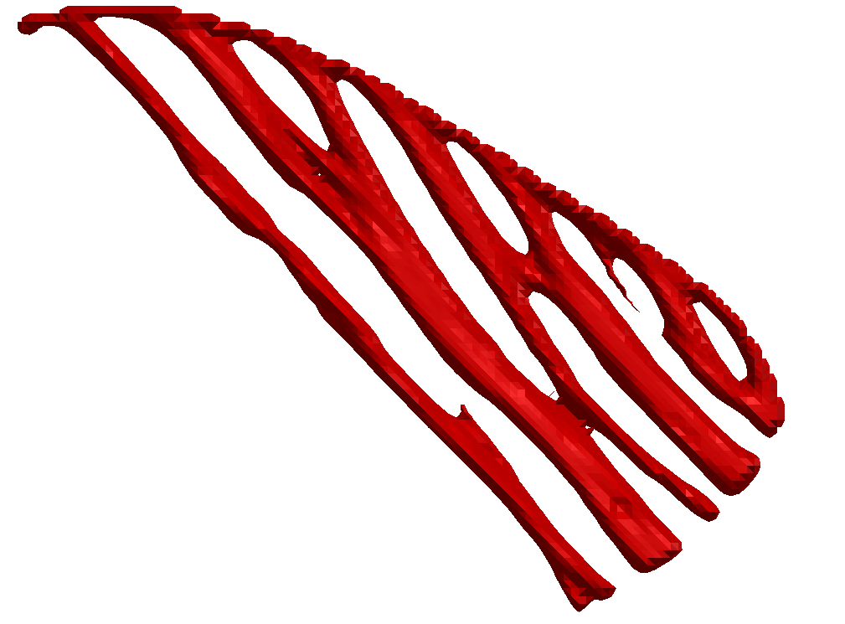
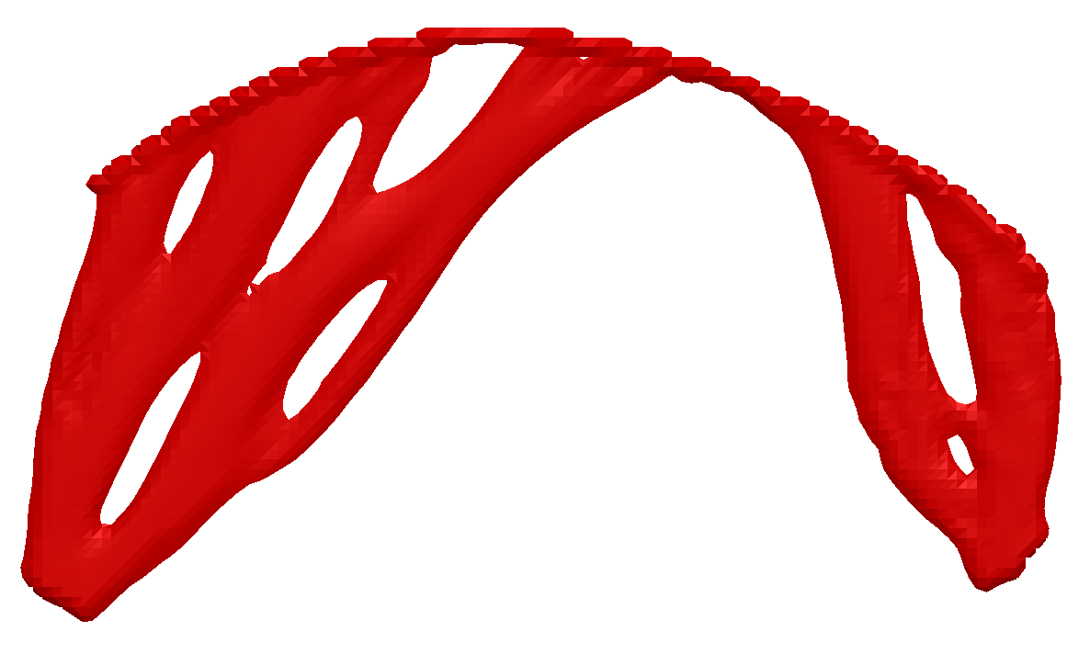
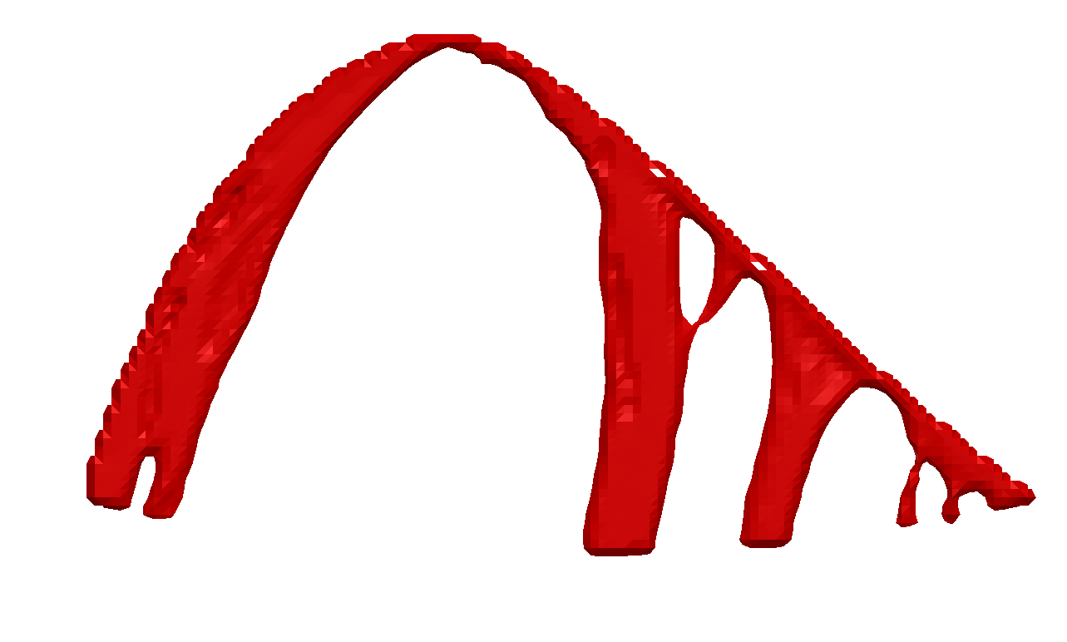
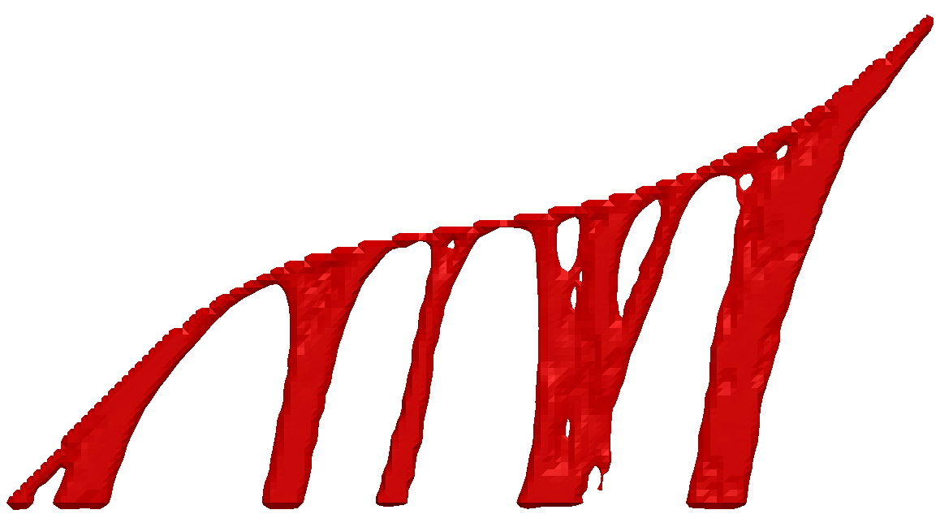
Results – TO domain
Support domain
Support Opt.
40%
Design

Slide 16



Conclusion
Generated supports that minimizes thermal compliance
Assumed a build orientation – optimal orientation ?
Representative heat load Actual heat load (?)
Overhang constraint defined implicitly
Q = ?

Slide 17

www.ersl.wisc.edu
achandrasek3@wisc.edu
ksuresh@wisc.edu

Slide 18



Figure bin

Slide 19

Fiber Optimization results
[Lund 2005]

Slide 20

Fiber Optimization results
[Henrichsen 2015]

Slide 21


Fiber Optimization results
[Hvejsel 2011]
[Duvaut 2000]

Slide 22






Fiber optimization
Composite materials – Topology optimization –
Material placement ? ( topology and orientation)
Anisotropic material – Stronger along particular direction
[Zhang 2017]
T
Q
[Lund 2005]

Slide 23




Fiber Optimization results
Surface gradient
Fiber orientation
Use pseudo-fibers to control density gradient

Slide 24


Material Model - Decay
Small value
Overhang angle
Conductivity function of angle
Decay rate
Material const

Slide 25


Material Model - Penalize
Overhanging element
Void element
Contributes to volume constraint ( )
Element not in final topology

Slide 26




Material Model -Anisotropic
Flat profile for
Design
Vertical supports

